Slide 1
AIRLINE RESERVATION
TEAM MEMBERS:
SRI MEDA
SUSHMA SUDAM SAMANTA CHAUHAN RACHIT LALLA
PROJECT GLADIATOR

Slide 2
Components(Functionality):
Add-flight
Admin-login
Delete-Flight
Error
Flight-search
Flight-select
Register
Seat-select
Ticket
c
Update-flight
UserLogin
View-all-flights
App-Component

Slide 3
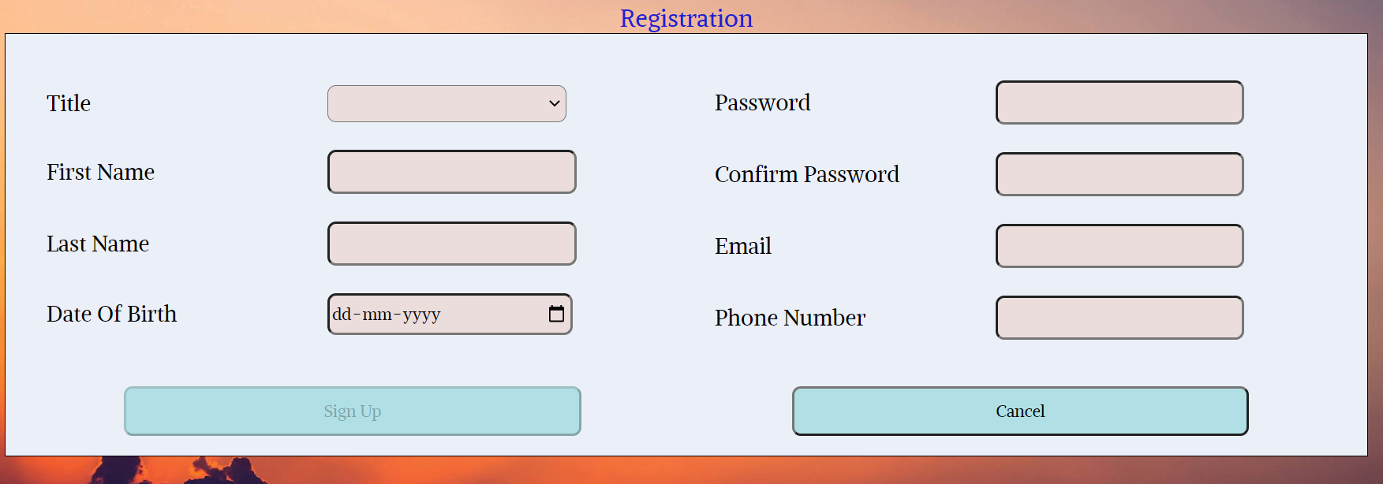
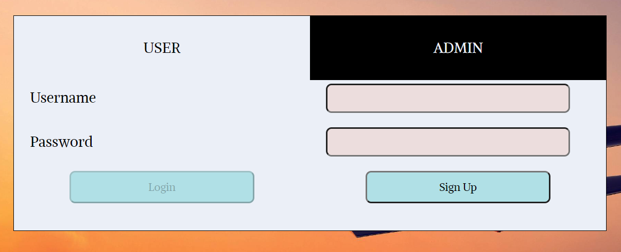
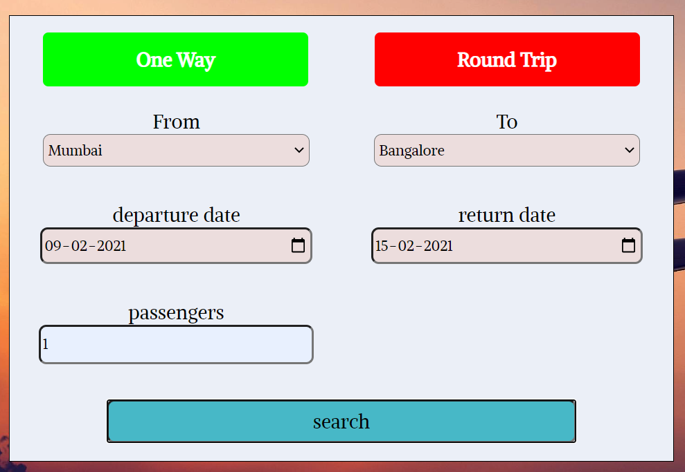
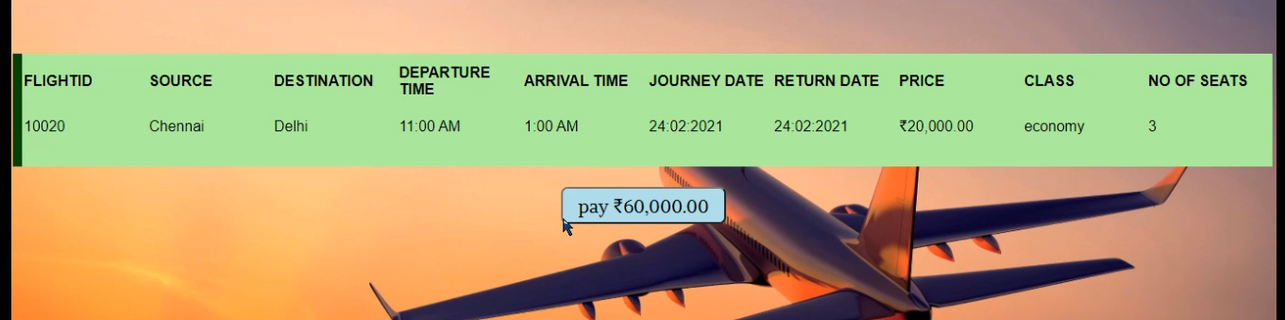
Flow: User Registration, Login, View Flights, Select Seats

Slide 4
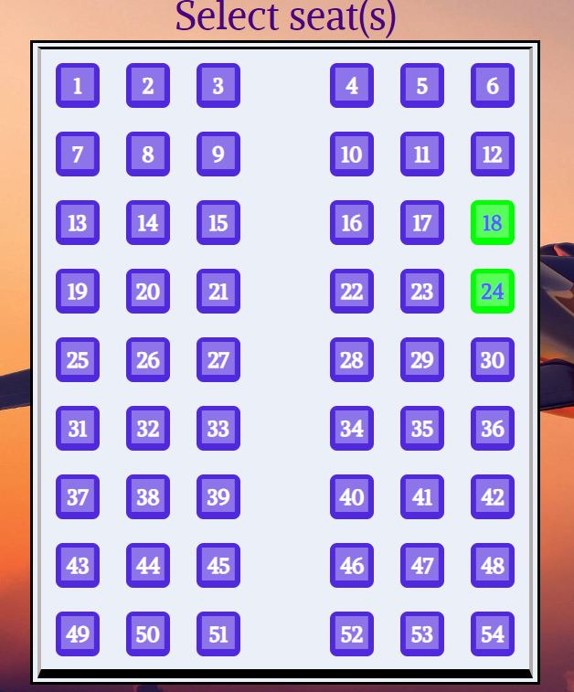
Flow: Continued

Slide 5
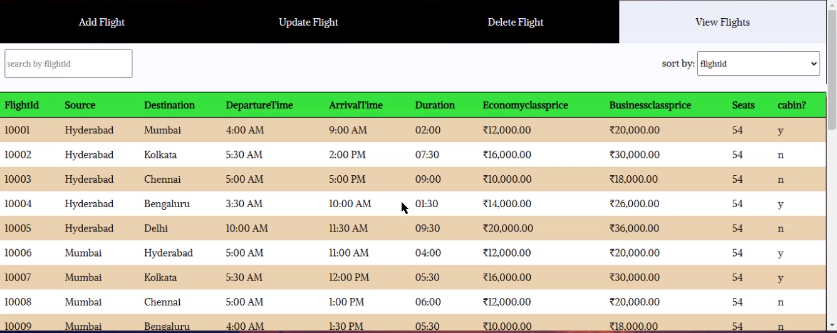
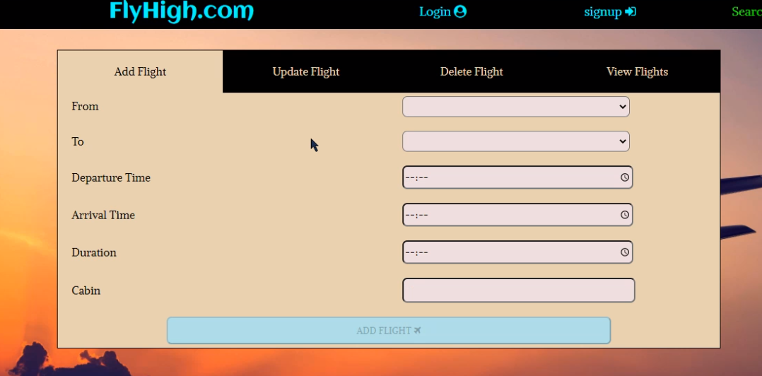
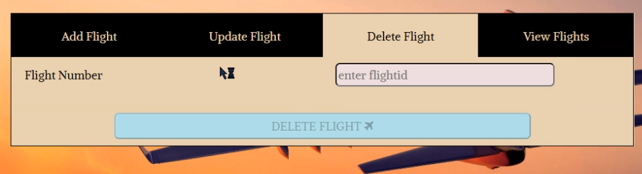
Flow: ADMIN CRUD OPERATIONS

Slide 6
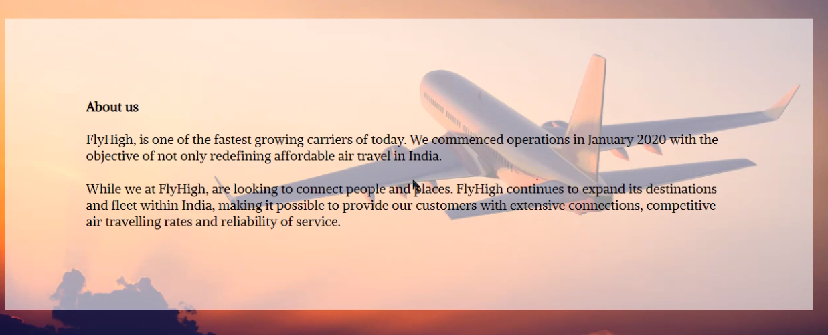
Flow: About us Page

Slide 7
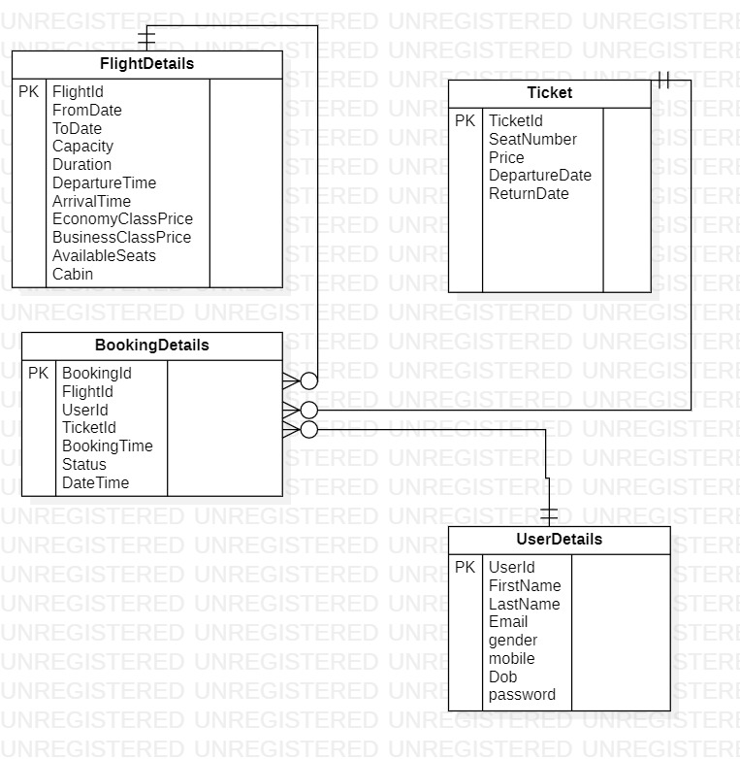
Database Schema-ER Diagram

